Slide 1
Advances in Hierarchical Clustering
of Vector Data
Joint work with Moses Charikar, Vaggos Chatziafratis, Rad Niazadeh (Stanford), AISTATS’19
Grigory Yaroslavtsev
Indiana University (Bloomington)
http://grigory.us/blog

Slide 2
Clustering
Key problem in unsupervised learning
Workshop at TTI-Chicago “Recent Trends in Clustering”
Tentatively, end of August, stay tuned!
Machine
Learning
Algorithms
Clustering

Slide 3
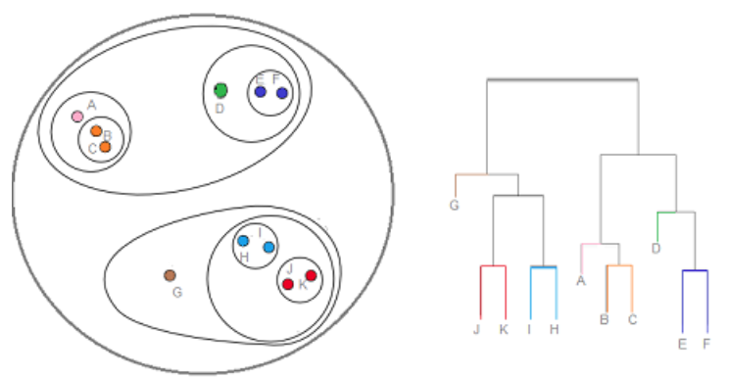
Hierarchical Clustering of Clustering Methods
Flat (single) clustering
# clusters K is fixed
K-means, K-median, K-center, etc
# clusters selected by the algorithm
Correlation clustering
…
Hierarchical clustering
Tree over data points,
Can pick any # of clusters
Relationships between clusters

Slide 4
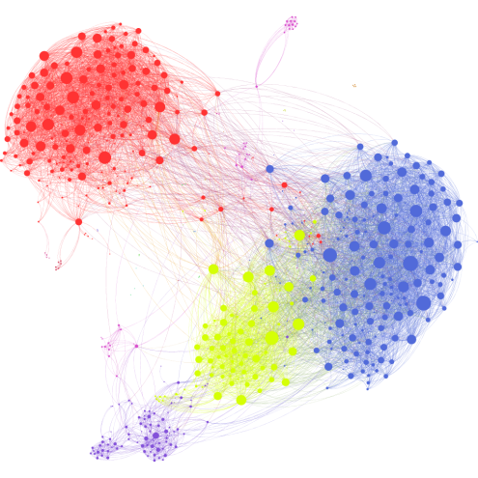
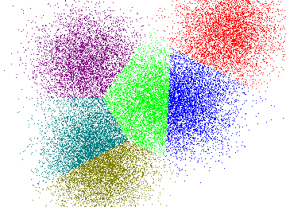
Data we can hierarchically cluster
Graphs (weighted graph G(V,E))
Recent work with Facebook
[Avdiukhin, Pupyrev, Y. VLDB’19?]
Scales to the Facebook graph
Up to${10}^{10}$ vertices, ${10}^{12}$ edges
Vectors $(v_{1},…, v_{n}∈ ℝ^{d})$
Arbitrary

Slide 5
Why little theoretical progress on HC?
Lots of heuristics, (almost) no rigorous objectives
Bottom-up (linkage-based heuristics)
Single-linkage clustering
Average-linkage clustering
Complete-linkage clustering
Centroid linkage
All sorts of other linkage methods
Implementations of HC in:
Mathematica, R, Matlab
SciPy, Scikit-learn, …

Slide 6
Bottom-up linkage-based heuristics
Start with singletons
Iteratively merge two closest clusters

Slide 7
Single-Linkage Clustering
Distance = distance between two closest points

Slide 8
MST: Single-Linkage Clustering
[Zahn’71]$k$ clusters: remove $k−1$ longest MST edges
Objective: maximizes minimum cluster distance
Not true if MST is approximate (sum vs. $k$-th edge)!
Scalable algorithms for Single-Linkage Clustering of vectors [Y., Vadapalli ICML’18]
Objective: maximize min(a,b,c)
Notes:
“”

Slide 9
Complete Linkage
Distance = distance between two furthest points

Slide 10
Average-Linkage Clustering
$\text{Distance}\text{ = }\text{average} \text{distance} \text{between} \text{points}$

Slide 11
Distance vs. Similarity
Distance $d(u,v)$
Arbitrary
M$etric: d(u,v)$ satisfies triangle inequality
Vectors: $||v_{i}−v_{j}||_{2}$
$$d\left(v_{i}, v_{j}\right)=||v_{i}−v_{j}||_{2}=\sqrt{\sum_{k=1}^{d}{{{(v}_{ik}−v_{jk})}^{2} }}$$

Slide 12
Distance vs. Similarity
Similarity $ρ\left(u,v\right)∈[0,1]$
Arbitrary: symmetric, $ρ\left(u,u\right)=1$
Metric case: monotone with distance
Vector case:
Threshold: $ρ\left(v_{i}, v_{j}\right)=$
Gaussian kernel: $ρ\left(v_{i}, v_{j}\right)=e^{−\frac{||v_{i}−v_{j}||_{2}^{2}}{2σ^{2}}}$
{
1, if $d\left(v_{i}, v_{j}\right)≤θ$
0, if $d\left(v_{i}, v_{j}\right)>θ$

Slide 13
Dasgupta’s objective for HC [STOC’16]
Given n data points and similarity measure $ρ$
Build a tree T with data points as leaves
For a pair of points $(u,v)$:
$$penalty\left(u,v\right)=ρ\left(u,v\right)×(min \# leaves in a subtree containing u,v)$$
$$penalty\left(u,v\right)=3 × ρ(u,v)$$
$$u$$
$$v$$

Slide 14
Dasgupta’s objective for HC [STOC’2016]
Given n data points and similarity measure $ρ$
Build a tree T with data points as leaves
For a pair of points $(u,v)$:
$$penalty\left(u,v\right)=ρ\left(u,v\right)(min \# leaves in a subtree containing u,v)$$
Minimize:
$$\sum_{u≠v}{penalty(u,v)}=\sum_{u≠v}{ρ\left(u,v\right)|LCA(u,v)|}$$
$\text{LCA}\text{(}\text{u}\text{,}\text{v}\text{) = }\text{Least} \text{Common} \text{Ancestor}$ of $(u,v)$ in T
$\text{|}\text{LCA}\text{(}\text{u}\text{,}\text{v}\text{)}|$ = # leaves under LCA(u,v)

Slide 15
Dasgupta’s objective for HC [STOC’2016]
Given n data points and similarity measure $ρ$
Build a tree T with data points as leaves:
Minimize: = $\sum_{u≠v}{ρ\left(u,v\right)|LCA(u,v)|}$
$\text{|}\text{LCA}\text{(}\text{u}\text{,}\text{v}\text{)}|$ = # leaves under LCA(u,v)
Currently best known approximation $O(\sqrt{\log{n}})$ [Charikar, Chatziafratis, SODA’17; Roy, Pokutta NIPS’16]
LP/SDP-based algorithms, don’t scale to large datasets
As hard as Sparsest Cut (no constant-factor approx. under UGC)

Slide 16
Moseley-Wang objective for HC [NIPS’17]
Given n data points and similarity measure $ρ$
Build a tree T with data points as leaves:
Maximize:$\sum_{u≠v}{score\left(u,v\right)=}\sum_{u≠v}{ρ\left(u,v\right)(n − \left|LCA\left(u,v\right)\right|)}$
$score\left(u,v\right)$ =$n− \left|LCA\left(u,v\right)\right|$
$\text{|}\text{LCA}\text{(}\text{u}\text{,}\text{v}\text{)}|$ = # leaves under LCA(u,v)
$$score\left(u,v\right)=2 × ρ(u,v)$$
$$u$$
$$v$$

Slide 17
Moseley-Wang objective for HC [NIPS’17]
Given n data points and similarity measure $ρ$
Build a tree T with data points as leaves:
Maximize:$\sum_{u≠v}{score\left(u,v\right)=}\sum_{u≠v}{ρ\left(u,v\right)(n − \left|LCA\left(u,v\right)\right|)}$
$score\left(u,v\right)$ = $n − \left|LCA\left(u,v\right)\right|$
$\text{|}\text{LCA}\text{(}\text{u}\text{,}\text{v}\text{)}|$ = # leaves under LCA(u,v)
Average-linkage gives 1/3-approximation [Moseley, Wang, NIPS’17]
Random recursive partitioning also gives 1/3 (in expectation)
Best known approximation is 1/3 + $δ$[Charikar, Chatziafratis,Niazadeh SODA’19]
Uses SDP, doesn’t scale to large data
Average-linkage can’t beat 1/3

Slide 18
Random recursive partitioning [MW’17]
Algorithm: Split points randomly and recurse
Analysis: Decompose the objective over triples
$$\sum_{u≠v}{ρ\left(u,v\right)\left(n−\left|LCA\left(u,v\right)\right|\right)=}\sum_{u≠v≠w}{ρ\left(u,v\right)I\left[w is not under LCA\left(u,v\right)\right]}$$
$$u$$
$\sum_{u≠v≠w}{ρ\left(u,v\right)I\left[w is not under LCA\left(u,v\right)\right]}=$
$$\sum_{u<v<w}{ρ\left(u,v\right)I\left[w is not under LCA\left(u,v\right)\right]}+$$
$$ρ\left(u,w \right)I\left[v is not under LCA\left(u,w\right)\right]$$
$$ρ\left(w,v\right)I\left[u is not under LCA\left(w,v\right)\right]$$
$$v$$
$$w$$
$OPT≤\sum_{u<v<w}{max\left(ρ\left(u,v\right),ρ\left(u,w\right), ρ\left(v,w\right)\right)=}$Max-Upper

Slide 19
Random recursive partitioning [MW’17]
Algorithm: Split points randomly and recurse
Analysis: Decompose the objective over triples
$$\sum_{u≠v}{ρ\left(u,v\right)\left(n− \left|LCA\left(u,v\right)\right|\right)=}\sum_{u≠v≠w}{ρ\left(u,v\right)I\left[w is not under LCA\left(u,v\right)\right]}$$
$OPT≤\sum_{u<v<w}{max\left(ρ\left(u,v\right),ρ\left(u,w\right), ρ\left(v,w\right)\right)=}$Max-Upper
$$\text{𝔼}\text{[}\text{ALG}\text{] = }\text{𝔼}\left[\sum_{u≠v≠w}{ρ\left(u,v\right)I\left[w is not under LCA\left(u,v\right)\right]}\right]$$
= $\sum_{u≠v≠w}{ρ\left(u,v\right) Pr\left[w is not under LCA\left(u,v\right)\right]]}$
$$=\frac{1}{3}\sum_{u≠v≠w}{ρ\left(u,v\right)=\frac{1}{3}\sum_{u<v<w}{ρ\left(u,v\right)+ρ\left(u,w\right)+ρ\left(v,w\right)}}≥\frac{1}{3}\sum_{u<v<w}{max\left(ρ\left(u,v\right),ρ\left(u,w\right), ρ\left(v,w\right)\right)≥}\frac{1}{3}OPT$$
$$u$$
$$v$$
$$w$$

Slide 20
Can we do better for vector data? [Charikar,Chatziafratis,Niazaheh,Y. AISTATS’19]
$d=1$ ($ρ\left(x_{i},x_{j}\right)=f(|x_{i}−x_{j}|)$)
Algorithm: Random-Cut ($x_{1}≤x_{2}…≤x_{n}$)
Pick $r$ uniformly at random in $\left[x_{1},x_{n}\right]$
Recursively cluster points in $[x_{1},r]$ and $[r, x_{n}]$
Analysis: Gives ½-approximation
$OPT≤\sum_{x_{i}<x_{j}<x_{k}}{max\left(ρ\left(x_{i},x_{j}\right),ρ\left(x_{i},x_{k} \right), ρ\left(x_{j},x_{k}\right)\right)}$
$$≤\sum_{x_{i}<x_{j}<x_{k}}{max\left(ρ\left(x_{i},x_{j}\right), ρ\left(x_{j},x_{k}\right)\right)}$$
$$𝔼[ALG]≥\frac{1}{2}\sum_{x_{i}<x_{j}<x_{k}}{max\left(ρ\left(x_{i},x_{j}\right), ρ\left(x_{j},x_{k}\right)\right)}$$
$$x_{1 } x_{2}{ x}_{3}{ x}_{4}{ x}_{5}$$

Slide 21
Can we do better for vector data? [Charikar,Chatziafratis,Niazaheh,Y. AISTATS’19]
$d=1$ ($ρ\left(x_{i},x_{j}\right)=f(|x_{i}−x_{j}|)$)
Average-linkage also gives $½$
Conjectures:
Average-linkage gives ¾?
Dynamic programming gives the optimum solution?

Slide 22
Can we do better for vector data?
$$v_{1},…, v_{n}∈ ℝ^{d}$$
In general, not easier than the general case
General instances can be embedded into high-dimensional vectors
Average-linkage can’t beat 1/3 even for vectors

Slide 23
Projected Random Cut Algorithm
$$v_{1},…, v_{n}∈ ℝ^{d}$$
Algorithm:
Pick random Gaussian $g∼N_{d}\left(0,1\right)$
Compute projections $x_{i}=⟨v_{i},g⟩$
Run Random Cut on ($x_{1},…, x_{n}$)

Slide 24
Projected Random Cut Algorithm
Theorem: Projected Random Cut gives $\frac{1+δ}{3}$ approximation under the Gaussian kernel similarity $ρ\left(v_{i},v_{j}\right)=\exp\left(−\frac{||v_{i}−v_{j}||_{2}^{2}}{2 σ^{2}}\right),$where $δ=\min_{i,j} ρ\left(v_{i},v_{j}\right)$
Key lemma: probability of not scoring an edge of a triangle is proportional to the opposite angle

Slide 25
Key lemma
$\operatorname{Pr}\left[v_{3} is under LCA\left(v_{1},v_{2}\right)\right]=\frac{{ θ}_{1}}{ π}$

Slide 26
Projected Random Cut gives $\frac{1+δ}{3}$
$$OPT≤\sum_{v_{i}<v_{j}<v_{k}}{max\left(ρ\left(v_{i},v_{j}\right),ρ\left(v_{j},v_{k}\right), ρ\left(v_{i},v_{k}\right)\right)}$$
$$𝔼\left[ALG\right]=$$
$\sum_{v_{i}<v_{j}<v_{k}}{\left(1 −\frac{{ θ}_{v_{i}v_{j}}}{π}\right)ρ\left(v_{i},v_{j}\right)+\left(1 −\frac{{ θ}_{v_{j}v_{k}}}{π}\right)ρ\left(v_{j},v_{k}\right)+\left(1 −\frac{{ θ}_{v_{i}v_{k}}}{π}\right)ρ\left(v_{i},v_{k}\right)}$
If $ρ(v_{i,}v_{j})$ is largest then we score it with prob. $≥\frac{1}{3}$

Slide 27
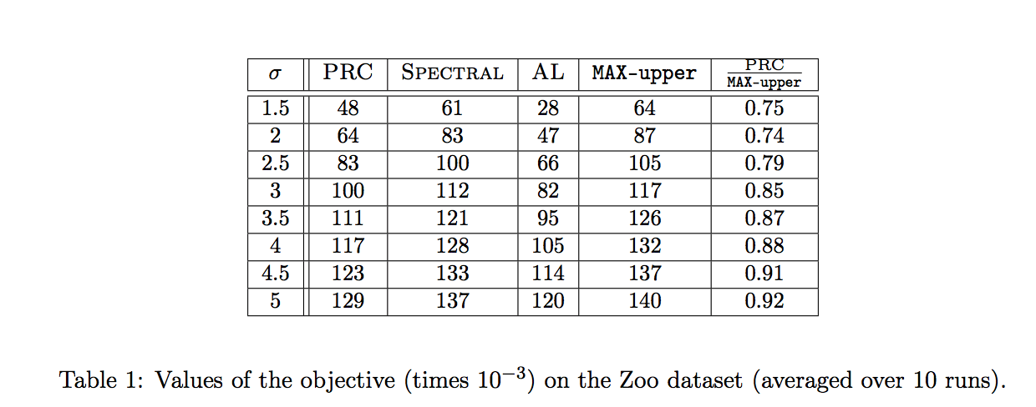
Experimental results for PRC

Slide 28
Scaling it up
Ran PRC on largest vector datasets from UCI ML repository (SIFT 10M, HIGGS)
Approx. ${10}^{7}$ points in up to 128 dimensions
$O(nd+n\log{n})$ running time
Can run on much larger data too
Can scale Single-Linkage clustering too, but
Uses PCA to reduce dimension
Requires a large Apache Spark cluster

Slide 29
Thank you!
Questions?
Some other topics I work(ed) on
Other clustering methods (e.g. correlation clustering)
Massively parallel, streaming, sublinear algorithms
Data compression methods for data analysis
Submodular optimization

